Slide 1
Introduction to Data Analysis

Slide 2
DATA PROCESSING
Patrick Boily Data Action Lab | uOttawa | Idlewyld Analytics
pboily@uottawa.ca

Slide 3

FOUR VERY IMPORTANT REMARKS
NEVER work on the original dataset. Make copies along the way.
Document ALL your cleaning steps and procedures.
If you find yourself cleaning too much of your data, STOP. Something might be off with the data collection procedure.
Think TWICE before discarding an entire record.

Slide 4
APPROACHES TO DATA CLEANING
There are two philosophical approaches to data cleaning and validation:
methodical
narrative
The methodical approach consists of running through a check list of potential issues and flagging those that apply to the data.
The narrative approach consists of exploring the dataset and trying to spot unlikely and irregular patterns.

Slide 5
Data Cleaning Bingo

Slide 6
TYPES OF MISSING OBSERVATIONS
Blank fields come in 4 flavours:
Nonresponse an observation was expected but none had been entered
Data Entry Issue an observation was recorded but was not entered in the dataset
Invalid Entry an observation was recorded but was considered invalid and has been removed
Expected Blank a field has been left blank, but expectedly so
Too many missing values (of the first three type) can be indicative of issues with the data collection process (more on this later); too many missing values (of the fourth type) can be indicative of poor questionnaire design.

Slide 7
THE CASE FOR IMPUTATION
Not all analytical methods can easily accommodate missing observations – 2 options:
Discard the missing observation
not recommended, unless the data is missing completely randomly in the dataset as a whole
acceptable in certain situations (such as a small number of missing values in a large dataset)
Come up with a replacement (imputation) value
main drawback: we never know what the true value would have been
often the best available option

Slide 8
TAKE-AWAYS
Missing values cannot simply be ignored.
The missing mechanism cannot typically be determined with any certainty.
Imputation methods work best when values are missing completely at random or missing at random, but imputation methods tend to produce biased estimates.
In single imputation, imputed data is treated as the actual data; multiple imputation can help reduce the noise.
Is stochastic imputation best? In our example, yes – but beware the No-Free Lunch theorem!

Slide 9
DETECTING ANOMALIES
Outliers may be anomalous along any of the unit’s variables, or in combination.
Anomalies are by definition infrequent, and typically shrouded in uncertainty due to small sample sizes.
Differentiating anomalies from noise or data entry errors is hard.
Boundaries between normal and deviating units may be fuzzy.
When anomalies are associated with malicious activities, they are typically disguised.

Slide 10
DETECTING ANOMALIES
Numerous methods exist to identify anomalous observations; none of them are foolproof and judgement must be used.
Graphical methods are easy to implement and interpret.
Outlying Observations box-plots, scatterplots, scatterplot matrices, Cooke's distance, normal qq plots
Influential Data some level of analysis must be performed (leverage)
Once anomalous observations have been removed from the dataset, previously “regular" units may become anomalous.

Slide 11
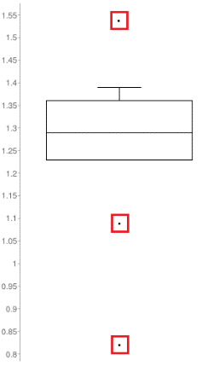
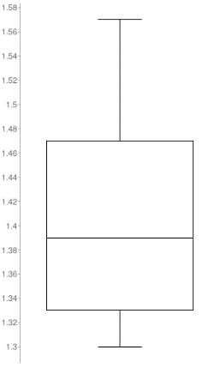
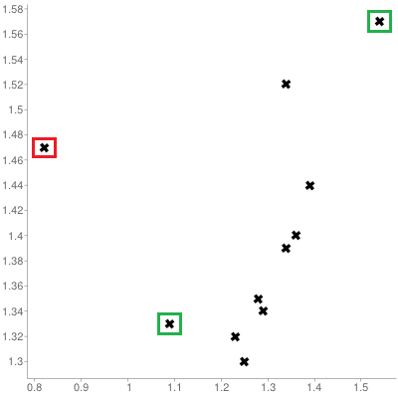
OUTLIERS
[Personal file]
Queuing dataset: processing rate vs. arrival rate

Slide 12
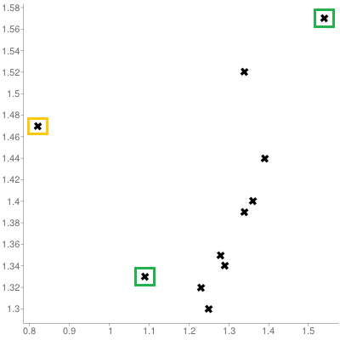
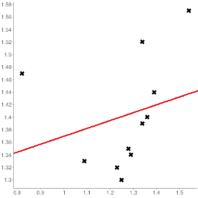
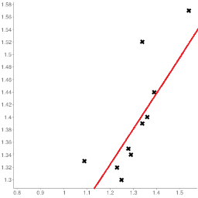
INFLUENTIAL OBSERVATIONS
[Personal file]
Queuing dataset: processing rate vs. arrival rate

Slide 13
TAKE-AWAYS
Identifying influential points is an iterative process as the various analyses have to be run numerous times.
Fully automated identification and removal of anomalous observations is NOT recommended.
Use transformations if the data is NOT normally distributed.
Whether an observation is an outlier or not depends on various factors; what observations end up being influential data points depends on the specific analysis to be performed.

Slide 14
DIMENSIONALITY OF DATA
In data analysis, the dimension of the data is the number of variables (or attributes) that are collected in a dataset, represented by the number of columns.
The term dimension is an extension of the use of the term to refer to the size of a vector.
We can think of the variables used to describe each object (row) as a vector describing that object.
Note: the term dimension is used differently in business intelligence contexts.

Slide 15
CURSE OF DIMENSIONALITY
Unless the dataset size grows exponentially with its dimension, the performance of any model we build is likely to suffer due to the Curse of Dimensionality.
Possible solutions:
sampling observations
feature selection (easy-ish) and/or dimension reduction (hard).
We look for ways to preserve the signal while shrinking the dimension: it’s easier to find needles in small haystacks!
(This is actually a thorny problem… but we’ll avoid the technical details in this course).

Slide 16
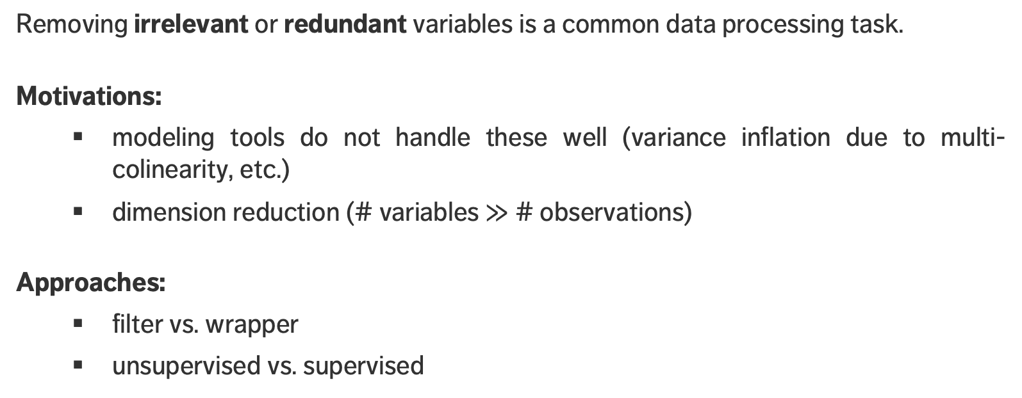
FEATURE SELECTION
Removing irrelevant or redundant variables is a common data processing task.
Motivations:
modeling tools do not handle these well (variance inflation due to multi-colinearity, etc.)
dimension reduction (# variables $≫$ # observations)
Approaches:
filter vs. wrapper
unsupervised vs. supervised

Slide 17
DISCRETIZING
To reduce computational complexity, a numeric variable may need to be replaced by an ordinal variable (from height value to “short”, “average”, “tall”, for instance).
Domain expertise can be used to determine the bins’ limits (although that could introduce unconscious bias to the analyses)
In the absence of such expertise, limits can be set so that either
the bins each contain the same number of observations
the bins each have the same width
the performance of some modeling tool is maximized

Slide 18
SOUND DATA
The ideal dataset will have as few issues as possible with:
Validity: data type, range, mandatory response, uniqueness, value, regular expressions
Completeness: missing observations
Accuracy and Precision: related to measurement and/or data entry errors; target diagrams (accuracy as bias, precision as standard error)
Consistency: conflicting observations
Uniformity: are units used uniformly throughout?
Checking for data quality issues at an early stage can save headaches later in the analysis.

Slide 19

SOUND DATA
accurate and precise
precise but not accurate
accurate but not precise
neither accurate nor very precise

Slide 20
TAKE-AWAYS
Don't wait until after the analysis to find out there was a problem with data quality.
Univariate tests don’t always tell the whole story.
Visualizations can help.
Context is crucial – you may need more context about the data in order to make sense of what you see… but whatever the situation, you need to understand the dataset quality.

